Slide 1
Portfolio Website
By Imperial-X

Slide 2
What’s the problem?
People face difficulties while making their resume which is actually a very important part of applying for jobs for any occupation.
Even if they manage to make a resume its usually very boring and unattractive or untidy, thus the recruiter loses interest.

Slide 3
So, what’s our website about?
Basically, our website makes the tedious task of making the resume of high profile companies very easy.
Our user-friendly interface helps the user to make a very attractive resume.

Slide 4
Future Scope
We would be able to build a resume more quickly and easily by introducing new features such as speech-to-text, etc.
We will use several algorithms to make the resume impressive and look attractive.

Slide 5
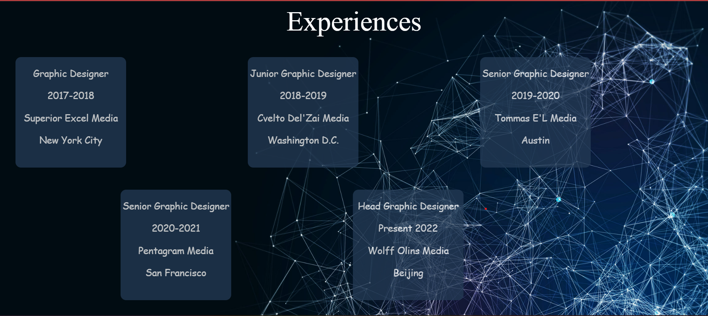
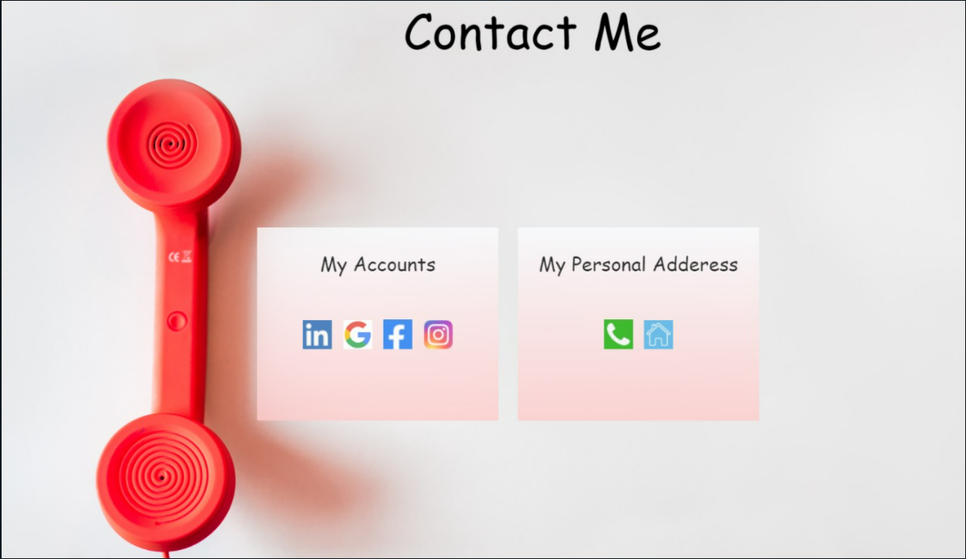
Snapshots of our website

Slide 6

THANK YOU

